Slide 1
Anlan Yang Juliana Sanchez-Tarazona Wen Pan Ruiqi Zhang Yuning Zhang

Slide 2

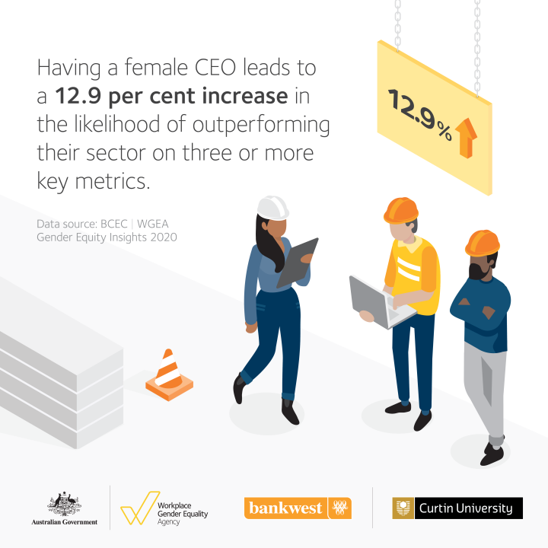
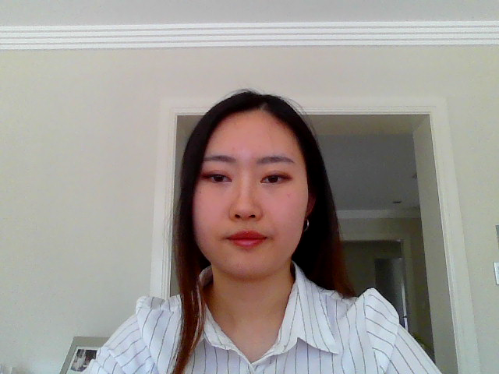
Notes:
Reference:
Harris, K. (2020). Kamala Harris on Twitter. https://twitter.com/KamalaHarris/status/1325251050509639681
WGEA. (2020). Gender Equity Insights 2020—Female CEO outperform sector. https://www.wgea.gov.au/media/gender-equity-insights-2020-female-ceo-outperform-sector

Slide 3
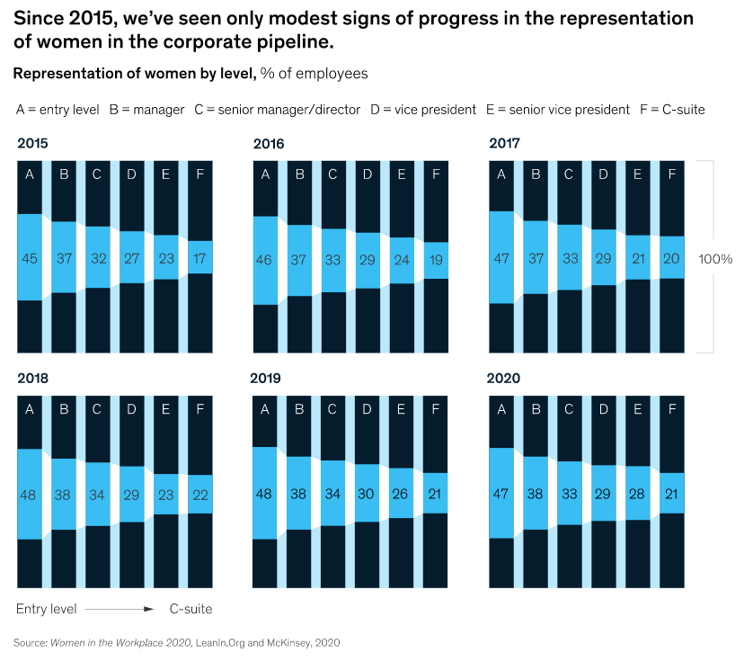

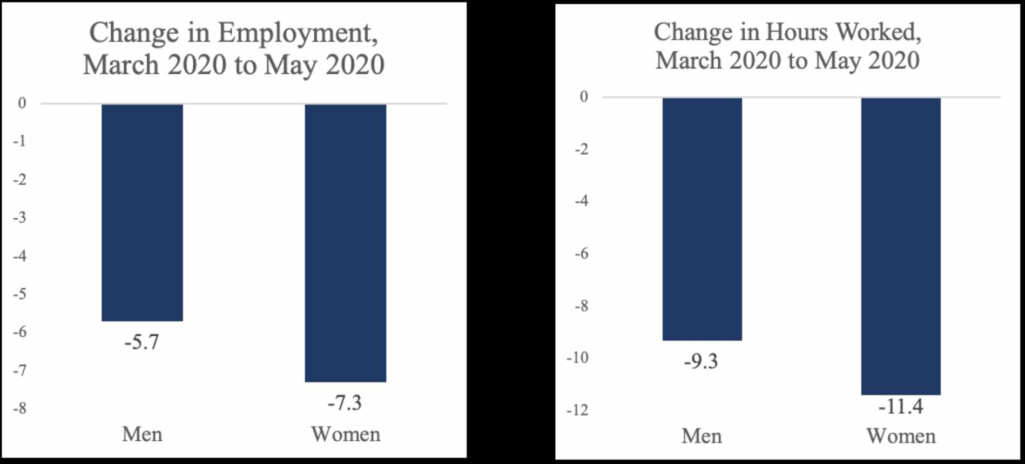
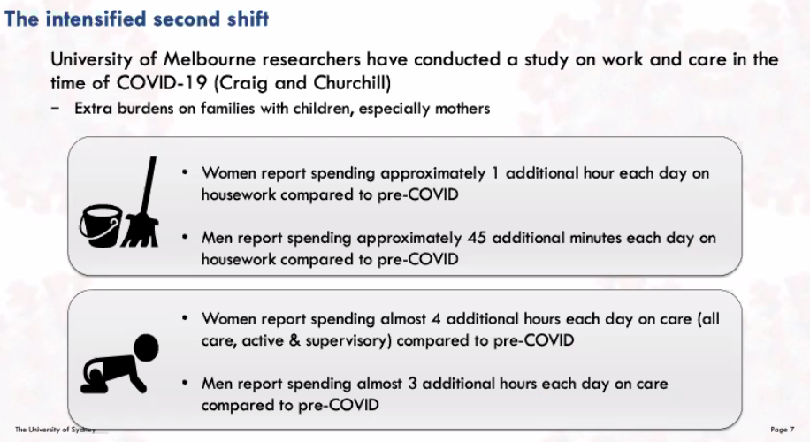

Women Leadership in Challenge
Women Leadership in Challenge
During this pandemic
Women spend 1 additional hour more than men each day on care (from University of Melbourne researchers)
2 million women are considering leaving the workforce (McKinsey, 2020)
Feminized jobs are essential but undervalued (Cooper and Mosseri, 2020)
Women representation in senior position has been decreasing by 1% (McKinsey, 2020)
BNAU Forum Pitch | Slide 2
Notes:
Reference:
Cooper, R., & Mosseri, S. (2020). Underutilised, Underpaid, Undervalued: Australian women and COVID-19 in and after the crisis. http://www.oecd-forum.org/posts/underutilised-underpaid-undervalued-australian-women-and-covid-19-in-and-after-the-crisis
McKinsey. (2020). Women in the Workplace 2020. https://www.mckinsey.com/featured-insights/diversity-and-inclusion/women-in-the-workplace

Slide 4



Political Action
Gender-responsive policies
Female involvement should be promoted
e.g. effective channels should be created for female frontline healthcare workers to voice their opinions
BNAU Forum Pitch | Slide 3

Slide 5


Economic Action
Gender-responsive budgeting and planning
Standard guidelines and tools
e.g. checklists, indicators and measures
BNAU Forum Pitch | Slide 4

Slide 6


Commercial Action
Gain and retain senior female talents
Create female-friendly workplace during pandemic
e.g. paid leave entitlements
BNAU Forum Pitch | Slide 5

Slide 7


Community Action
On- and offline meetings
Exchange ideas
Stay connected
Expend social networks
Mentoring opportunities
Develop leadership skills
Learn to balance work and family
BNAU Forum Pitch | Slide 6

Slide 8


Personal Action
See pandemic as an opportunity to learn and grow
Communities
Workshops
Balance work and life
Ensure mental and physical health
e.g. exercise and resilience training
Negotiate to share domestic responsibilities fairly
e.g. chore sharing app and time management app
BNAU Forum Pitch | Slide 7

Slide 9
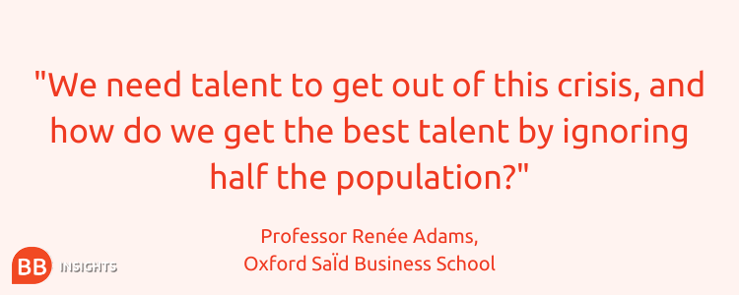

Conclusion
BNAU Forum Pitch | Slide 8

